Slide 1
Module 4 Final Project Presentation
FEMA Time Series Modeling
An investigation into the future of natural disasters in the U.S. by analyzing FEMA Natural Disaster Declarations start and end date and other data in an OpenFEMA Dataset for Disaster Declarations
By: Rachel Beery

Slide 2
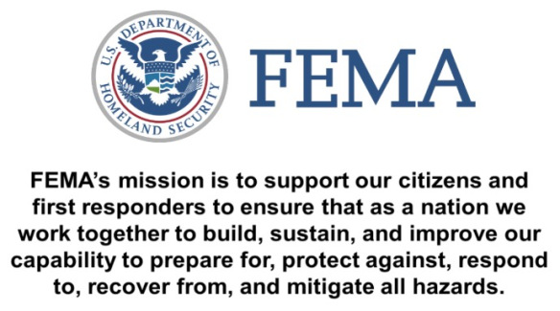

Slide 3
FEMA Natural Disaster Declarations
Data
Question
Prediction
This dataset lists all official FEMA Disaster Declarations, beginning with the first disaster declaration in 1953 and features all three disaster declaration types: major disaster, emergency, and fire management assistance. The dataset includes declared recovery programs and geographic areas.
What patterns can we find in natural disaster declarations to better help FEMA and citizens to prepare for natural disaster?
Seasonal preparation for Hurricanes
Increase in floods
Slow, but consistent occurrence of Severe Storms

Slide 4
Problem Statement
In the U.S. there are many natural disasters yearly that follow a pattern overtime
Our client FEMA has tasked us with finding out how many natural disasters will happen in the coming three years and how to more properly prepare for these natural disasters

Slide 5
Methodology:
Time Series Models

Slide 6
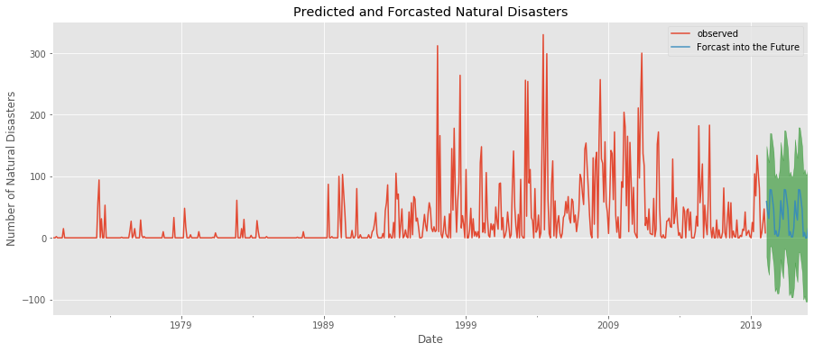
Time Series Model: Severe Storms

Slide 7
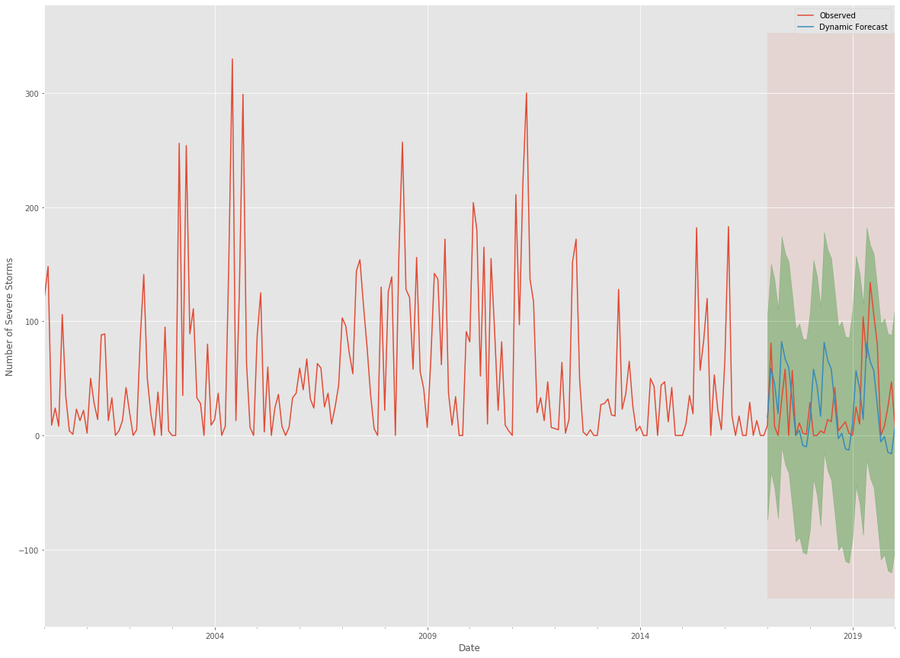

Slide 8
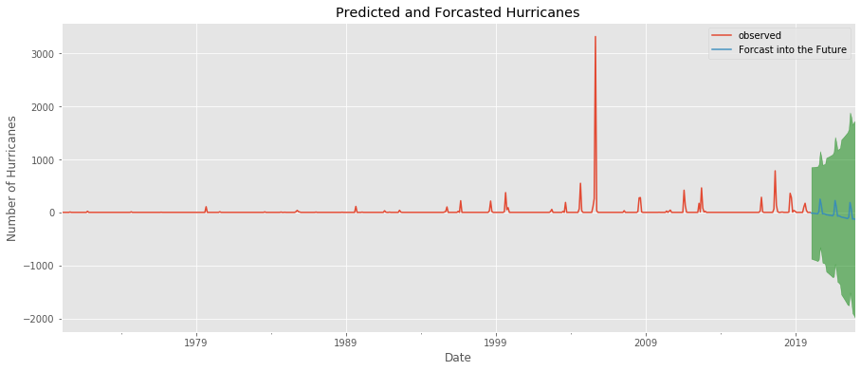
Time Series Model: Hurricanes

Slide 9
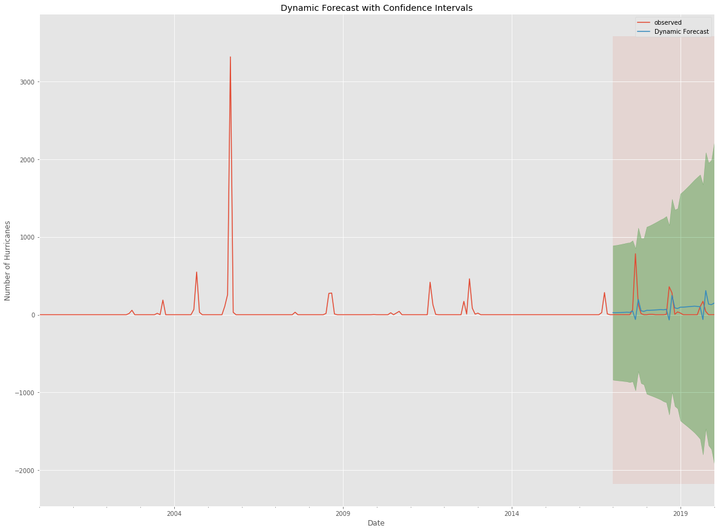
Time Series Model: Hurricanes

Slide 10
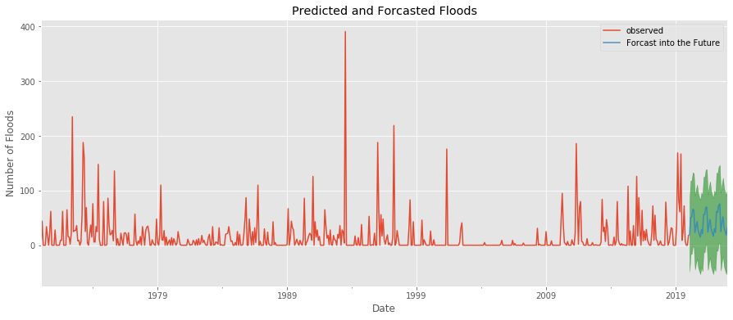
Time Series Model: Floods

Slide 11
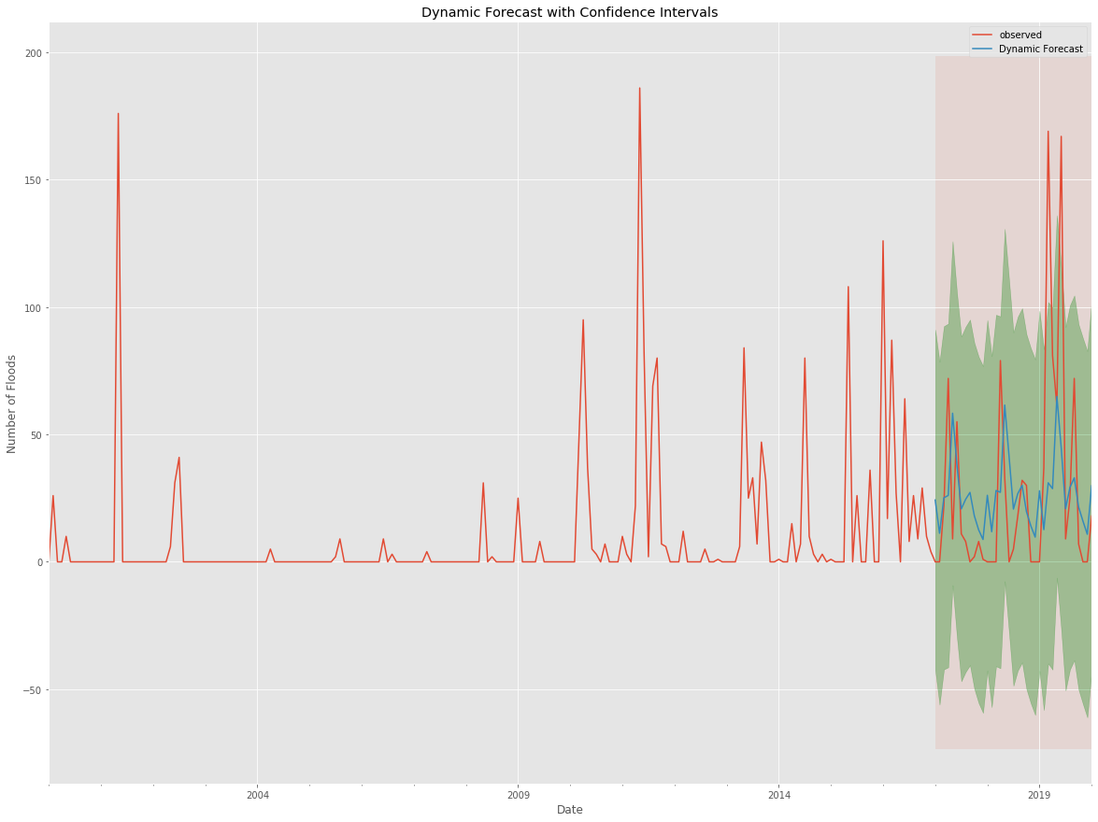
Time Series Model: Floods

Slide 12
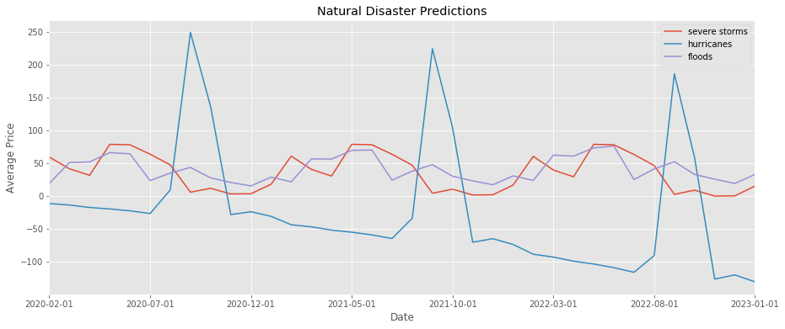

Slide 13
Recommendations
Severe Storms
Slow, but consistent occurrence
Hurricanes
Seasonality of August to October
Floods
Slow Increase

Slide 14
Future Work
Research areas of the U.S.
Biological Natural Disasters
COVID-19 & other possible pandemics
Snow, Fire, & Ice
Funding allocation
Community Preparation

Slide 15
Thank you!
Data provided by FEMA at the following website:
https://www.fema.gov/openfema-data-page/disaster-declarations-summaries-v2

Slide 16
Appendix

Slide 17
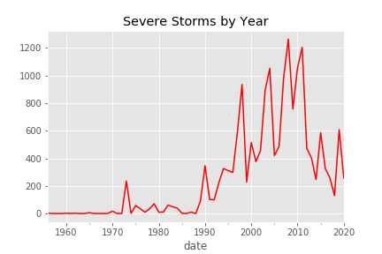

Slide 18
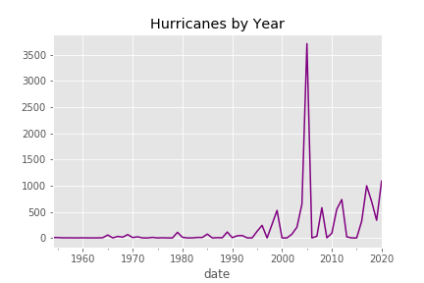

Slide 19
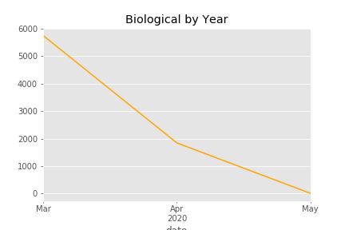

Slide 20
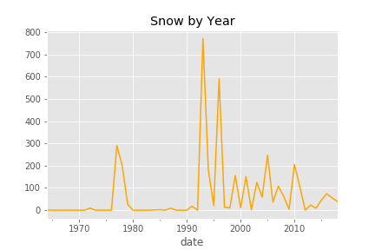

Slide 21
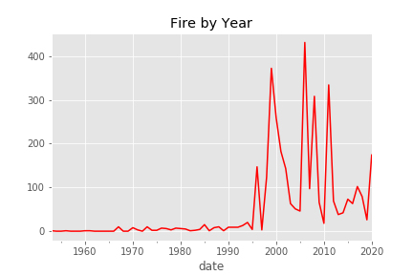

Slide 22
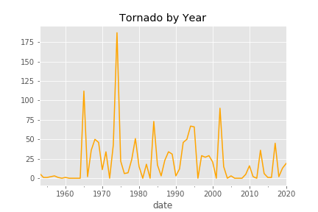

Slide 23
